Slide 1
Microsoft licensing
and deployment scenarios
NEXT

Slide 2
Presented by
Helen Põdra
Kädi Horm
NEXT

Slide 3
Presentation Highlights
Microsoft 365 for small and medium-sized businesses
Microsoft 365 for enterprises
Azure and Azure RI
Microsoft Fast Track program
Support Packages introduction
NEXT

Slide 4
SMB Licensing
through CSP
up to 300 users
1 - 300 users
Annual fixed price guarantee
Flexibility to add or remove products
Billing monthly or annually
Wide range of products
NEXT

Slide 5
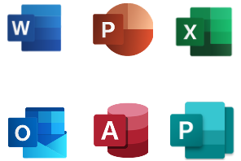
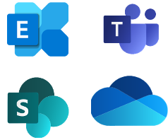
Microsoft 365 Business Basic
Microsoft 365 Business Standard
Microsoft 365 Business Premium
Microsoft 365 Apps for Business
Microsoft 365 Apps for Enterprise
4.20€ per user/month
10.50€ per user/month
16.90€ per user/month
8.80€ per user/month
12.80€ per user/month
NEXT

Slide 6
CASE STUDY 1
Company „Lets work“
Best solution
45 users
20 Salespeople
Microsoft 365 Business Basic
20 Category Leads
Microsoft 365 Business Standard
5 Managers
Microsoft 365 Business Premium
20 Salespeople, who have a dedicated device but are constantly on the move
20 Category leads, who are daily in the office and mostly deal with administrative work
5 Managers, who are constantly traveling and have access to a lot of sensitive data
Annual budgeting
Licenses are managed by in-house IT team on regular bases
NEXT

Slide 7
CASE STUDY 2
Company „Best Accounting“
Best solution
30 users
25 Accountants
Microsoft 365 Business Premium
5 Board Members
Microsoft 365 Business Premium
25 Accountants, who are working from an office and have a lot of sensitive data at their disposal.
5 Managers, who travel constantly and have access to sensitive data
Annual budgeting
Offices in 20 countries
Licenses are managed by in-house IT team located in Vilnius
NEXT

Slide 8
Microsoft licenses for Enterprises
Office 365 (E1, E3, E5)
Microsoft 365 (E3 & E5)
300 +
Capable & flexible
Deployment
Subscribe and use
created for large companies,from 300 + users
With greater size comes greater responsibility. Large enterprise solutions offer more functionality, reliability & security
Aquired through Enterprise Agreement or CSP Agreement, both licensing and services needed
All Microsoft products/services are subscription-based
NEXT

Slide 9
The benefits of Microsoft 365 E-plans
Include more security, compliance, and mobile device handling functionalities compared to Office 365 plans.
Right of use for on-prem servers
No need to acquire on-prem Exc, SP when all users are covered with M365 E3 or E5
Flexible - all components can be ordered separately
Plans can be combined according to the profiling
NEXT

Slide 10
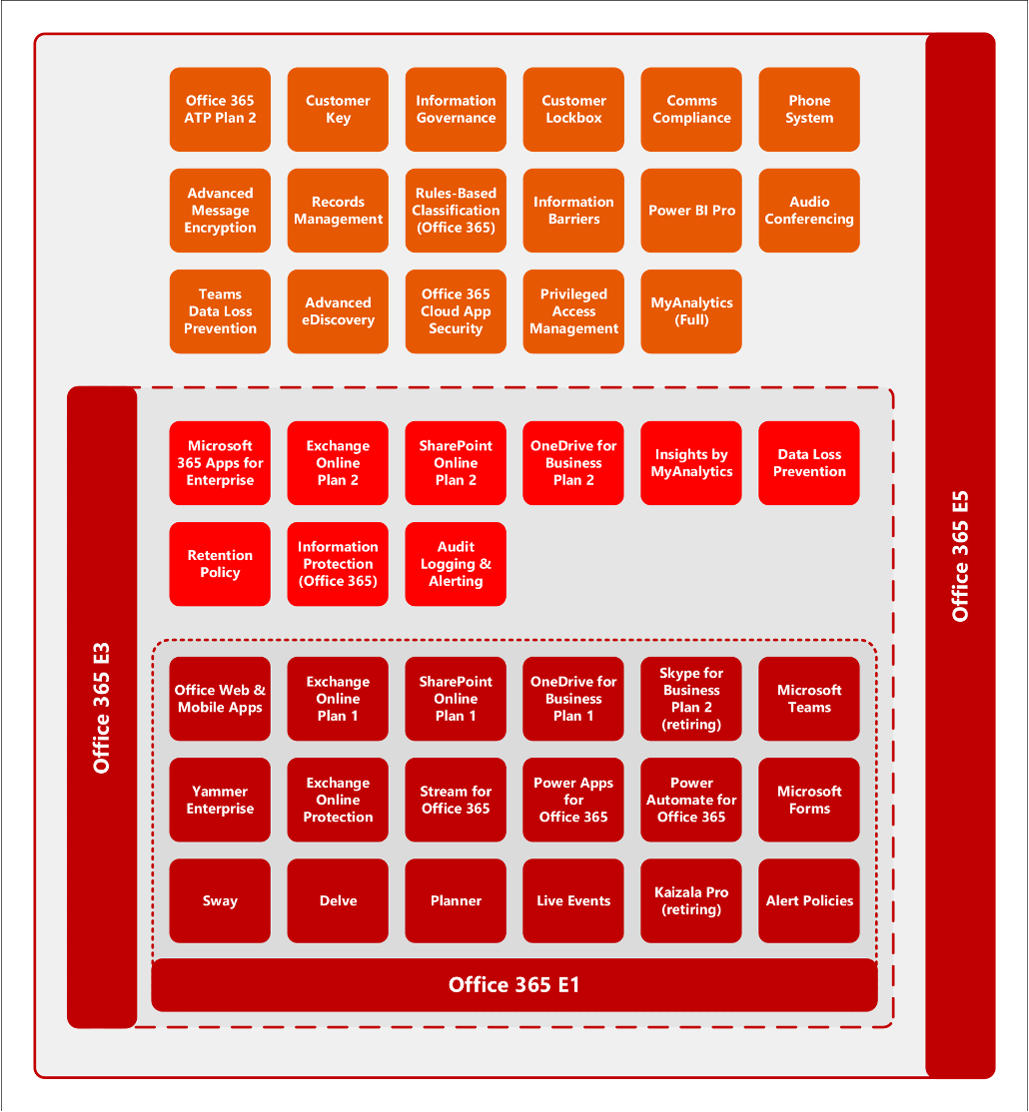
NEXT

Slide 11
What will you
get with
Microsoft 365
E-plans?
M365 E3
Office 365 E3
Enterprise Mobility and Security E3
Windows per-user E3
M365 E5
Office 365 E5
Enterprise Mobility and Security E5
Windows per-user E5
NEXT

Slide 12
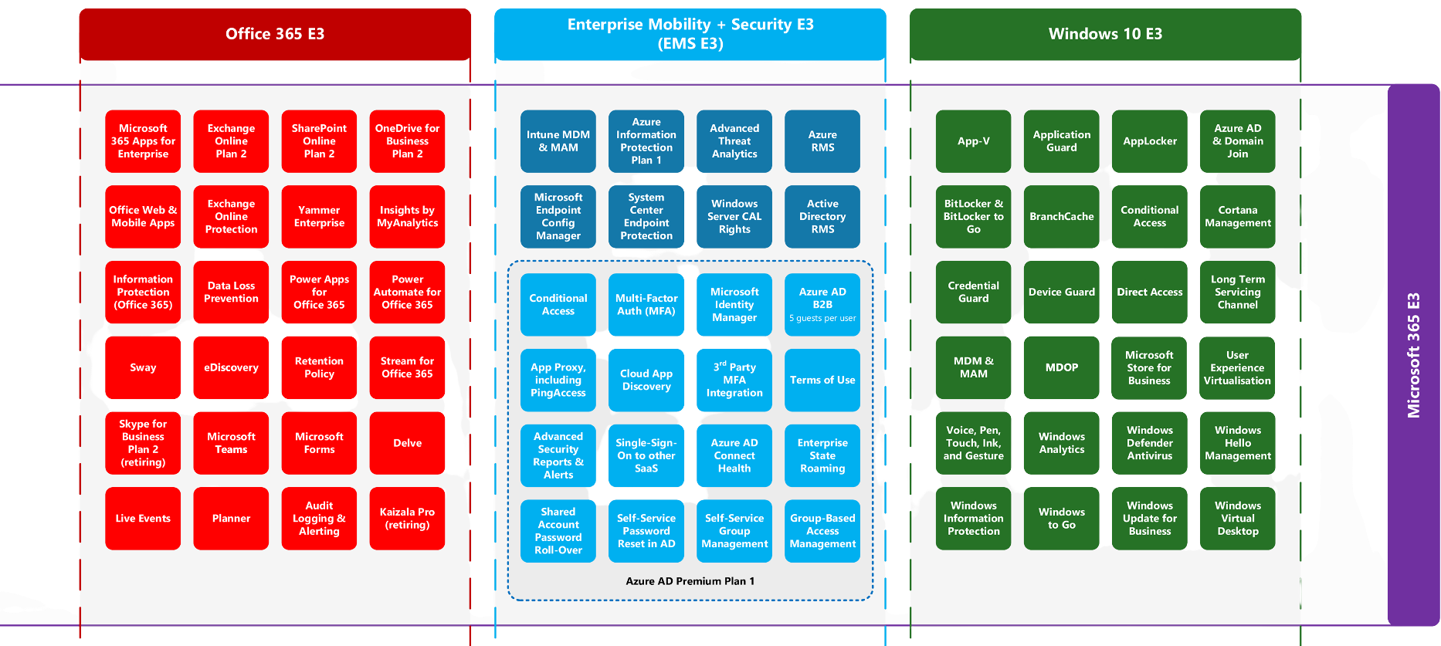
NEXT

Slide 13
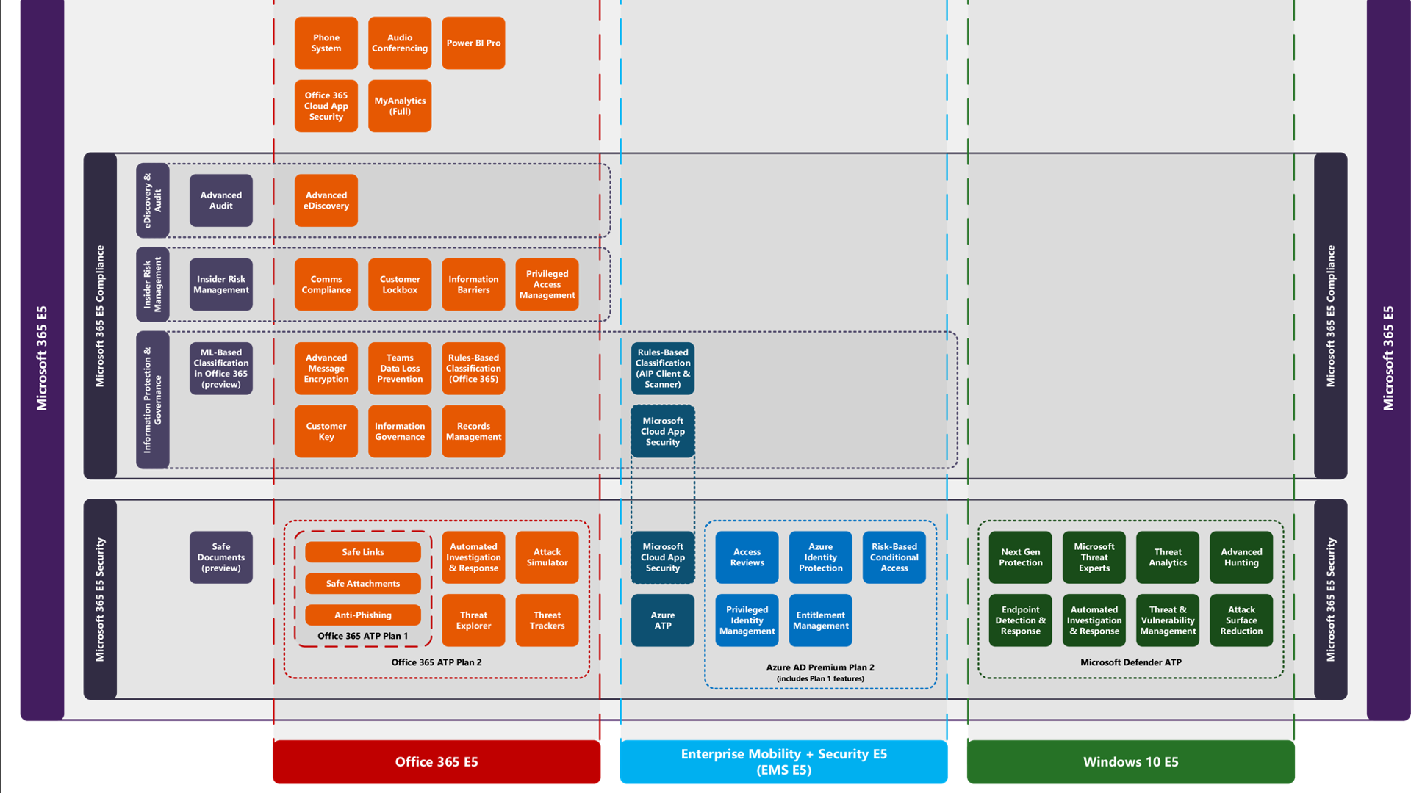

Slide 14
CASE STUDY 1
Company „Good Business“
Best solution
510 users
Office 365 E1 310 users
Office 365 E3 200 users
200 users are business users needing Office Desktop installed additionally to the cloud services (Exchange, SharePoint, Teams, OneDrive)
Suggested Agreement
Fixed budget for 3 years
ESA
Price fixed for 3 years (for products entered on the signing phase)
Payments once per year, reservations for online services
The least possible time spent on licensing
NEXT

Slide 15
CASE STUDY 2
Company „Best Business“
Best solution
Office 365 E1
there is no single license for Teams usage only
600 users
Need for Microsoft Teams
Valid EAS agreement
Suggested Agreement
Alternativly for „kiosk users“– Microsoft 365 F1*
* Rules for Kiosk users licensing are special and needs to be clarified if valid certain circumstances
NEXT

Slide 16
CASE STUDY 3
Company „The Greatest Business “
Best solution
500 users
Microsoft 365 E3 – 550 users
Azure AD Premium Plan 2 additional product– 50 users
Office 365 with desktop usage rights
All the users/devices should be handled mobile
The operating system is out of date;
50 IT department workers need additionally Azure AD Prem Plan 2
Suggested Agreement
CSP (monthly payments, 1-year agreement term, flexibility)
EAS (3 years fixed price, time saver)
NEXT

Slide 17
What are the licensing options
ESA/EA
CSP
500 + users
Fixed Contract period: 3 years
Annual reporting
Convenient, comfortable, and budget-friendly
1 +users
Fixed prices for 1 year
Flexibility in adding and removing users
Billing annually or monthly
NEXT

Slide 18
Microsoft Azure
What's the best option for me?
Monetary Commitment
Through EA/EAS agreement
Upfront payments
Overage billing
Pay as You Go
Through CSP agreement
Pay according to use
Usage by services
Available through EAS and CSP
Rich pool of choices - requires specific knowledge
azure.microsoft.com/en-us/pricing/calculator/
NEXT

Slide 19
Azure RI
Smart choice for better pricing
01
02
03
Number of discount possibilities
Versatile planning capabilities
Flexible payment arrangements
Discount program for Azure services
Advance planning capability of 1-3 years allows for budget savings
Can be ordered through CSP program, paying monthly bases and through EAS agreement as a part of monetary commitment
NEXT

Slide 20
Next step
Fast Track
Helps to ensure the successful deployment and user adoption of Microsoft 365 solutions at optimal costs.
NEXT

Slide 21
Why use FastTrack?
Professional transition
to the cloud
Cost-efficient
Access to the best
technical know-how
Time-efficient
Deployment process is professionally managed
Guided support
NEXT

Slide 22
Support Packages
Support package 10
Mapping of the current situation
Consultation and development suggestions
Pro Support Package 15
Mapping of the current situation
Consultation and development suggestions
2nd of support service 8.00 am to 6.00 pm
Advanced Support Package 15
Mapping of the current situation
Consultation and development suggestions
24/7 Support
Technical support
SLA max 2h
Training for the main user and end users
Software Assurance benefits will end 30.06.2021
NEXT

Slide 23
Mapping of the current situation*
Consultation*
2nd level support
User support service
Technical Support
Mapping of business requirements
Identification of the requirements of the company
Establishing a vision for the future
Mapping of issues
Mapping of the IT solutions currently in use
Result of mapping of the current situation: first assessment and next steps
Introduction of new services
Strategic activity plan: an overview of new developments in the IT area
How to migrate into the cloud
Sharing the best practices and recommendations
Help with Microsoft licensing and training
Detailed analysis if required
Project plan
Main user trainings
2 sessions 2h per month
Support service for server, network, and other services
MS365 helpdesk support service
Support service of cloud services
IT Manager and consultation
Support service for consolidation and connection of systems
TABLOO intranet support service
Escalation of problems to Microsoft and help via Microsoft Advanced support
O365 admin
Device management
Max 2h SLA
Analysis of infrastructure
Microsoft architects online consultation
Primend Azure support service
Management of solving technical errors resulting from the Microsoft services by Primend*
Proof of Concept
*If the first mapping is not sufficient, move on with Audit
*Consultations need to be agreed in advance; SLA 72h
*Not included: Migration and implementation of IT services, end-user training, setup, and optimization of network and servers
*Primend can guarantee response time on their part and provide to the client SLA time guaranteed by Microsoft under Microsoft Advanced Support Package

Slide 25
Šarūnas Čertokas
Primend UAB
sarunas.certokas@primend.com
mob +370 674 45776
www.primend.lt
Thank you!
Let's discuss further
Darius Grigaliūnas
Primend UAB
darius.grigaliunas@primend.com
mob +370 660 00 030
www.primend.lt

